Slide 1
Intro to RPi (Part 2)
By SUTD IEEE

Slide 2
Agenda
Using Firebase with RPi (the right way)
Running a Web Server on the RPi

Slide 3
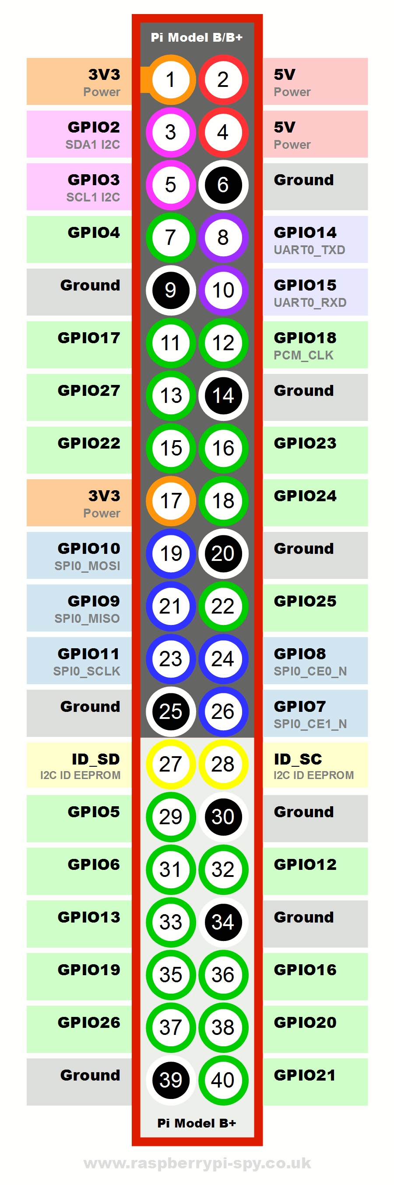
Rpi GPIO
https://pinout.xyz/#

Slide 4
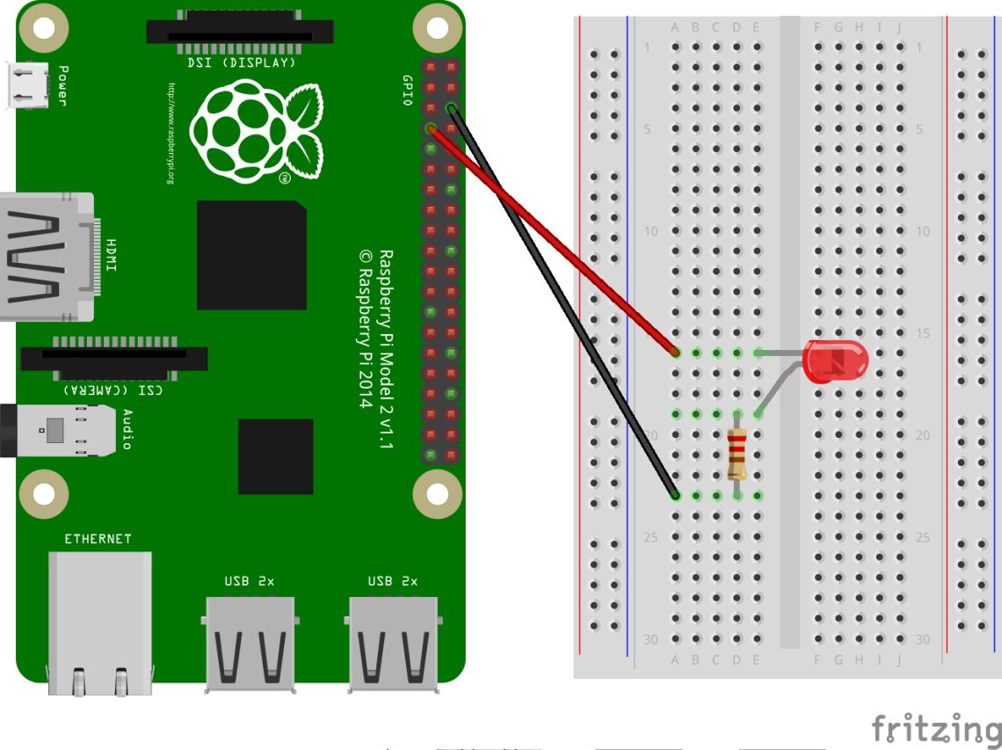
ACTIVITY SETUP
Connect +ve lead of LED (Longer leg) to BCM26
Refer to https://pinout.xyz/# !
Connect a resistor from the –ve lead of the LED to an empty space
Connect the resistor to a GND pin
Refer to https://pinout.xyz/# !

Slide 5
Firebase (The Right way)
‘Database Secrets’ is deprecated
‘python-firebase’ module not updated in 4 years
The right way?
Firebase Admin SDK (Python)

Slide 6
FIREBASE (THE RIGHT WAY)
Open your Firebase Console
Navigate to Project Settings >> Service Accounts
Generate new Private Key >> Save that file in your project folder

Slide 7
FIREBASE (THE RIGHT WAY)
In the Firebase Console:
Open Database Tab
Navigate to ‘Rules’
Change it to this: { "rules": { ".read": "auth.uid === ‘some_UID’”, ".write": "auth.uid === ‘some_UID’” } }
Publish

Slide 8
Firebase (The Right way)
How to install?
sudo pip3 install firebase-admin
Create a Python file
import firebase_admin
from firebase_admin import credentials
from firebase_admin import db

Slide 9
FIREBASE (THE RIGHT WAY)
cred = credentials.Certificate(‘PATH_TO_KEY')
firebase_admin.initialize_app(cred, {
'databaseURL': 'https://your_database.firebaseio.com/',
'databaseAuthVariableOverride': {
'uid': ‘your_uid'
}
})

Slide 10
FIREBASE (THE RIGHT WAY)
To use the database:
mydatabase = db.reference()
Get:
mydatabase.get()
mydatabase.child(‘some_child’).get()
Set:
mydatabase.child(‘some_child’).set( { “key”: “value” } )
Update
Push

Slide 11
FIREBASE (THE RIGHT WAY)
Refer to the template to learn how to continuously get a certain database entry

Slide 12
Firebase (The Right Way)
Your task:
Write another file that asks for an input (on/off) and updates a particular database entry using .set() -> On your computer
Run a script on the RPi to continuously read that same database entry and based on that turn an LED on/off.

Slide 13
Flask Server
Flask is a Python framework that allows you to manage your web servers
It is not a web server! (Though it comes with a test server for … well, testing)
Install:
virtualenv:
sudo pip3 install virtualenv
mkdir myproject
cd myproject
virtualenv myvenv
. myvenv/bin/activate
To deactivate: type deactivate
flask:
pip3 install Flask
To run: type flask run –-host=0.0.0.0 -–port=8080

Slide 14
Flask Server
Refer to ‘flaskapp.zip’ in for example

Slide 15
The ENd

